Slide 1
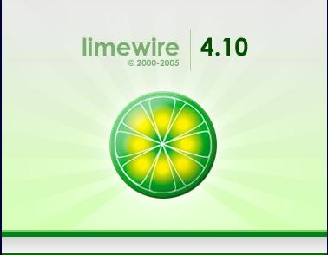

MP3 Critics
Web-Based Music Downloading Services
CSCI 110
Dr. Bowring
Matt Lyons
Jarrett Bouchette
Brittany Bridges

Slide 2
Overview
The purpose of our research was to evaluate the pros and cons of two competing online music downloading software. We chose Limewire and iTunes to be representative of the online music options available to consumers. We researched the development, features, and growth of each software.

Slide 3
Development
Online music downloads started with the development peer-to-peer (P2P) software. This software enables users to share music that has been uploaded in digital format. Napster was the first major platform to utilize this form of file-sharing of music.

Slide 4

Napster
In June of 1999 Shawn Fanning developed Napster, which enabled users to share their music, cost free, with anyone else who was using Napster. Within the same calendar year that Napster was released to the public, it was sued for copyright infringement by the RIAA.

Slide 5
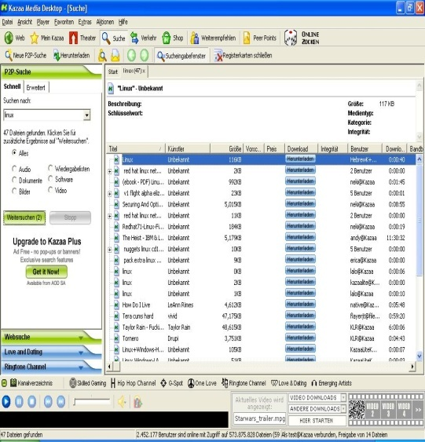

KaZaA
Napster set the precedent for P2P music downloading companies across the globe. In 2001 two people from Amsterdam created this software and took on the popularity that Napster had and at it’s peak was installed on 140 million computers worldwide. KaZaA was sued for similar lawsuits as Napster and was had to pay $100 million in reparations to four major recording industries.

Slide 6
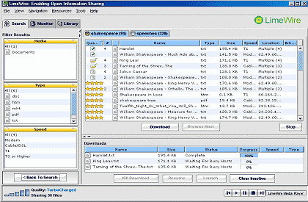
Limewire
Limewire is the newest P2P software that is used for free music downloading. Limewire does encourage its users to upgrade to Limewire PRO for $24.95 so they can use its upgrades. PRO version offers things that the regular version does not such as faster downloads, larger search options, background skins, and “Turbo Charged” downloads.

Slide 7
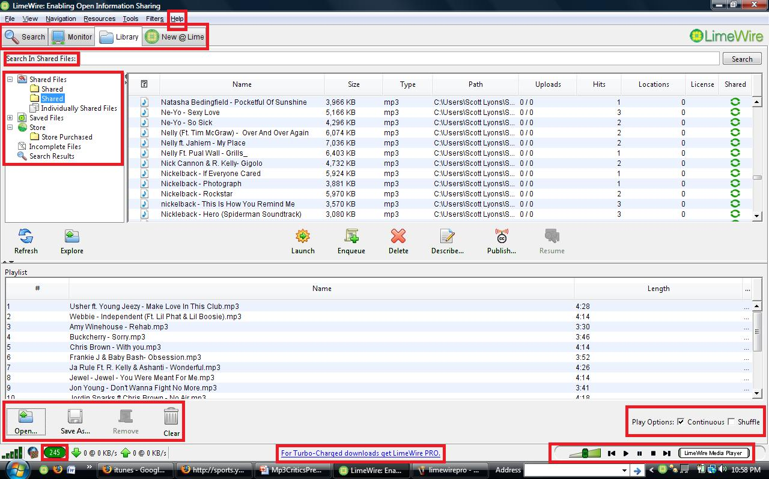

Slide 8
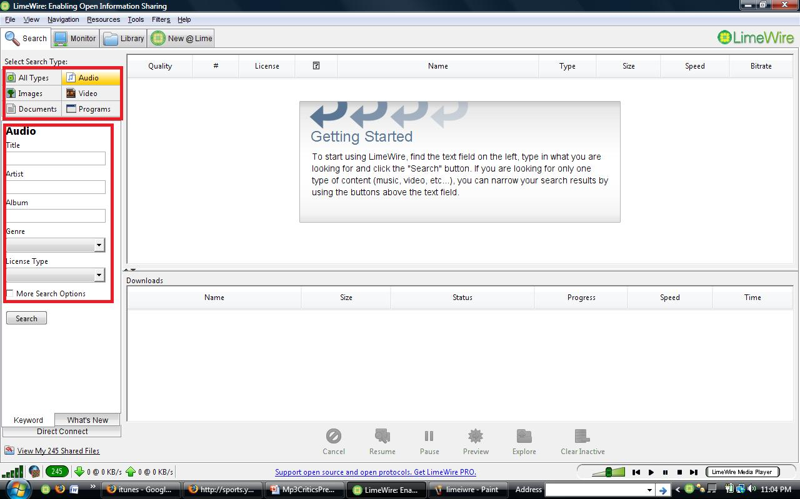

Slide 9
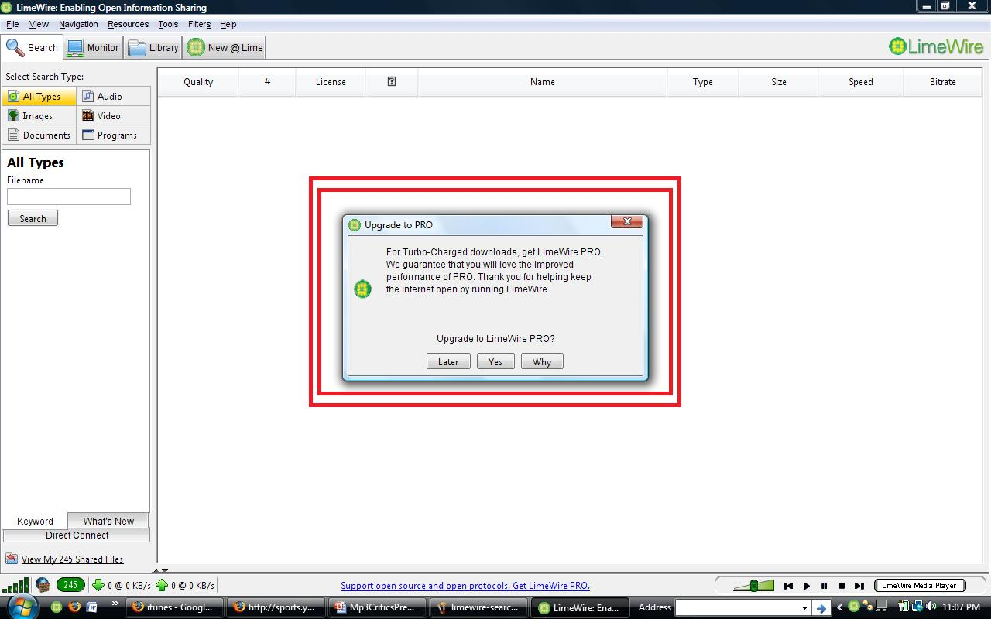

Slide 10
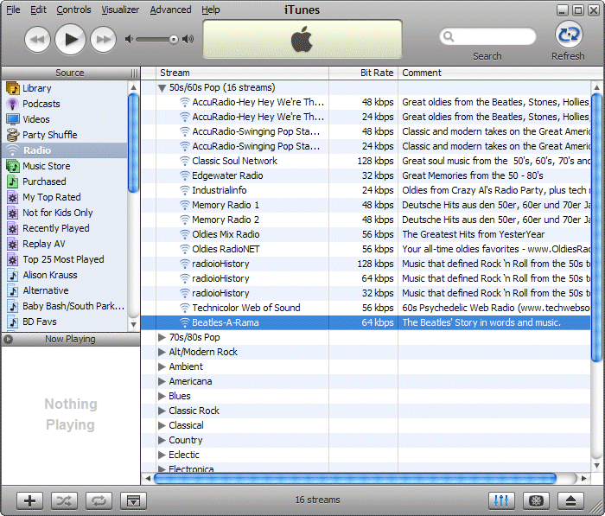
iTunes
In January of 2001 Apple Inc. introduced iTunes, a digital media player application. It was mainly promoted to help it’s other applications such as the iPod and recently released, iPhone. iTunes is a legal way to download music by paying a small fee per song, video, television show, games, etc. Even though introduced by Apple, it is compatible with Windows Vista and older versions.

Slide 11
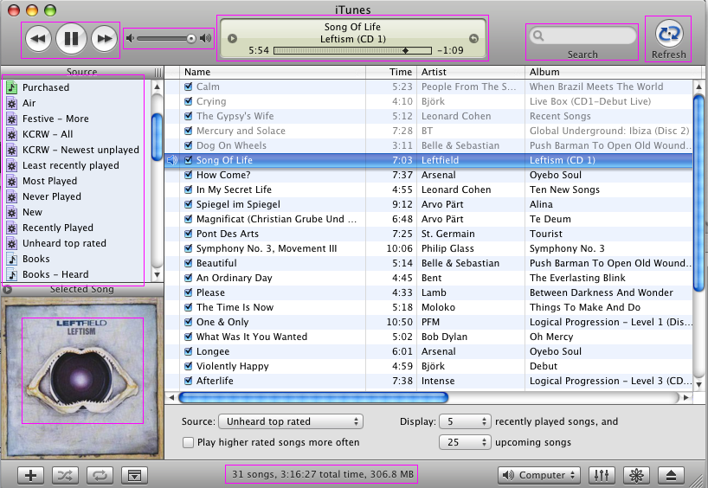

Slide 12
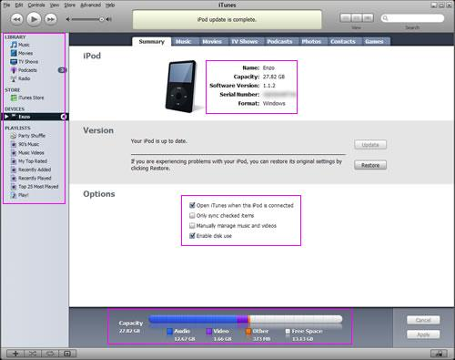

Slide 13
iTunes versus Limewire
 | Limewire | iTunes
Free of Charge? | Yes, but upgraded version available for $24.95 | No, small fee per download.
Compatibility? | Can run on any system with Java Virtual Machine installed. | Available for Macs, Windows, iPod, and iPhone with Digital Jukebox software installed.
Import Playlists? | Can rip from CDs. | Can rip from CDs, import Limewire playlists and other music downloading services.

Slide 14
Who uses Limewire and who uses iTunes?

Slide 15
Similarities
Despite the many differences they have many similarities. They share and transport copyrighted music files through public networks. Both software's have the abilities to make playlists of songs and also libraries. These libraries then can be shared through something called Digital Audio Access Protocol.

Slide 16
Differences
Limewire is useful because when it is downloaded, it can be saved and can go to any software just about except the iPod.
The iPod is restricted so that it is only compatible with songs from iTunes.

Slide 17
Growth in Online Music
In 2008 iTunes passes Wal-Mart as largest U.S. music retailer
¼ of all Americans over 12 years old have downloaded a music or Mp3 file from the net
The stat above equals out to 60 million people
28% of Americans admit to downloading music

Slide 18
Wrap Up
Music downloading is growing rapidly in the 21st century. Since the platform set by Napster, free music downloading is more popular than ever. Free services, such as Limewire, are more widely used today than Napster was in its era. Record companies and artists are starting to wonder how they are going to get paid fully for there work is companies such as iTunes and Limewire continue to become more popular.

Slide 19
References
Tanner, Adam, and Scott Hills. "ITunes Passes Wal-Mart as Top U.S. Music Retailer." Money. 04 Apr. 2008. USA Today. 17 Apr. 2008 <http://www.usatoday.com/money/media/2008-04-03-apple-itunes-sales-tops-wal-mart_N.htm>.
Zetner, Alejando. "Measuring the Effect of Music Downloads on Music Purchases." University of Chicago (2005).

